Slide 1
Predicting Possible road accident severity in seattle,wa

Slide 2
APPROACH – There are 6 steps to build a predictive model –
Business Understanding
Data Understanding
Data Preparation and Cleaning
Predictive Modelling
Evaluation
Deployment

Slide 3
Business Problem understanding and Target audience – To analyze the available data and build a model to predict the severity of possible accident.
The World Health Organization (WHO) estimated the economic costs derived from road accidents reached 518 billion USD per year in high income countries and 65 billion USD per year in medium and low-income countries.
Reporting indicated the number of fatalities from road accidents per year of about 1.3 million and 50 million injuries were recorded or an average of 3000 deaths/day and 30,000 injuries/day.
This project is particularly useful to Seattle Police Department, Traffic Controllers and the local residents using the road for travel.
This model should be able to predict the severity of the accident provided appropriate inputs are given.

Slide 4
Data understanding – The data has been provided by Seattle police department, recorded by traffic records and made available by IBM online certification team.
There are 38 columns in the provided data file.
There are 194673 rows or entries in the data file.
Data types vary from column to column.
There are many missing data entries which should either be replaced by ‘Unknown’ or ‘No’.
Some of column can be dropped because of either irrelevancy or repetition.
So many data columns have been provided twice. For example, ST_COLCODE and ST_COLDESC, SEVERITYCODE and SEVERITYDESC, etc.

Slide 5
Data preparation and cleaning – This is the first step to Data Analysis and Machine Learning in which data is converted into the required format so that operations can be run on.
This format should be complete in every aspect and should help the Scientist make his/her case.
The required dataframe should not contain any unwanted values or null values which can significantly affect the final model accuracy.
The null values should either be dropped from the dataframe or appropriate values should be putted to make it more sensible.
Since we are going to build a machine learning model, the data converted into numerical form is best to run models on.
These 7 columns were selected, by dropping all the irrelevant columns, to build the predictive model –
[‘severity’, ‘weather’, ‘road’, ‘light’, ‘influence’, ‘inattention’, ‘speeding’]

Slide 6
Exploratory data analysis – Data was analyzed by plotting various kinds of plots for visualization and there relativity was noted.
The relationship between independent variables and dependent variable has to be explored so that only relevant data is selected.
It is well established fact that weather conditions, road conditions and lighting conditions plays major role in the driving experience.
In this section, human factors such as inattention, speeding and whether he/she was under the influence of drugs were also explored.
Some extraordinary observations were noted during exploring the relationship of severity of accident with individual variables.

Slide 7
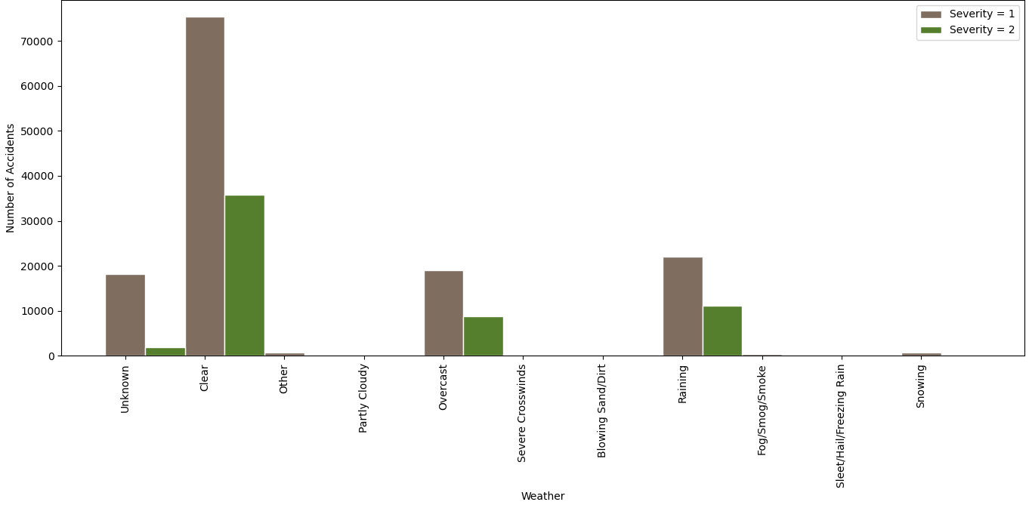
Severity vs Weather Conditions –
Since clear weather is usual atmospheric condition so it is obvious that maximum number of accidents happened in clear weather.
Raining was second most dangerous weather condition for road driving.
Overcast contributed significantly in raising the accident count and since it has no affect on the driving experience, this is very strange thing to note.

Slide 8
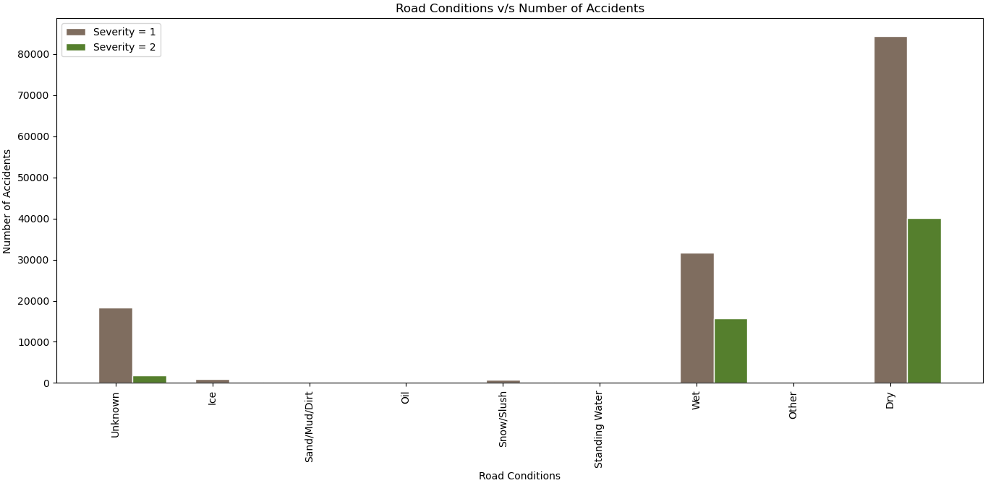
Severity vs Road Conditions –
Similar to clear weather, dry road condition is most prevalent so maximum accidents will occur in dry conditions only.
As expected, wet conditions had significant impact.

Slide 9
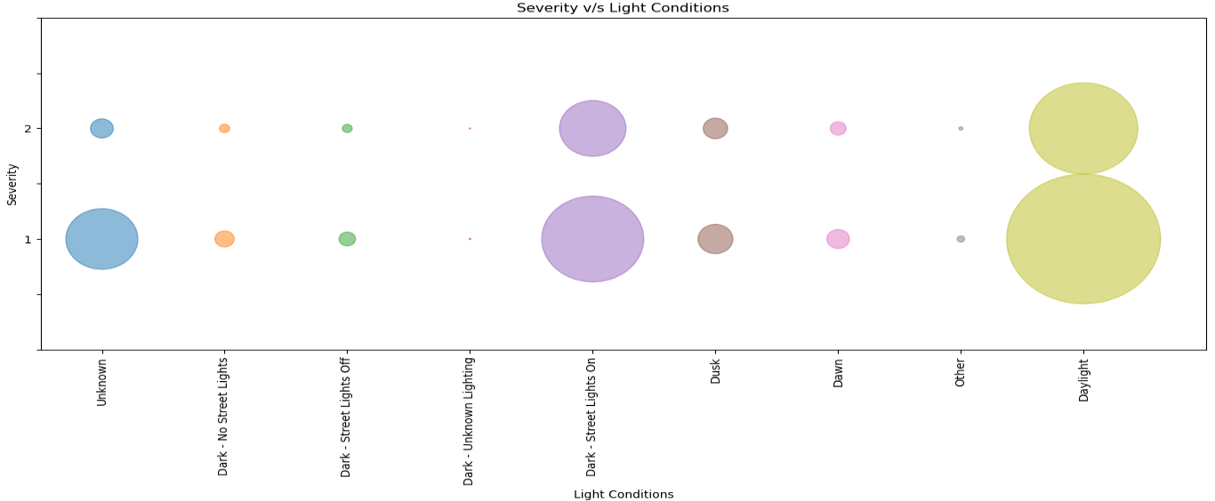
Severity vs Lighting Conditions –
Daylight and Dark - Street Lights On were main lighting conditions for accident number.
As expected, Dark conditions had significant impact.

Slide 10
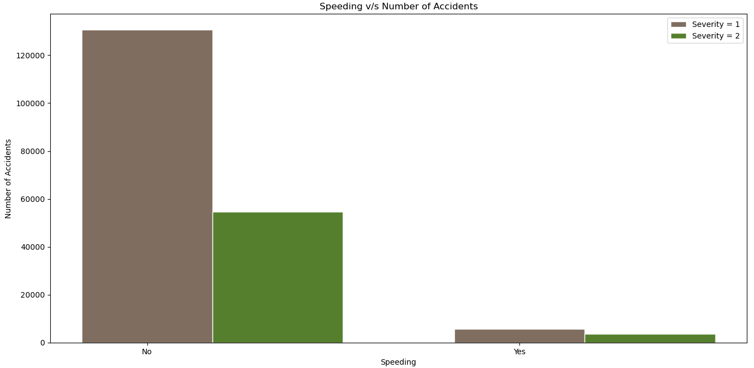
Severity vs Speeding –
Speeding | Severity = 1 | Severity = 2 | severity = 2 cases %age of total cases
Yes | 5802 | 3531 | 37.83%
No | 130638 | 54657 | 29.5%
yes cases %age | 4.25% | 6.07%

Slide 11
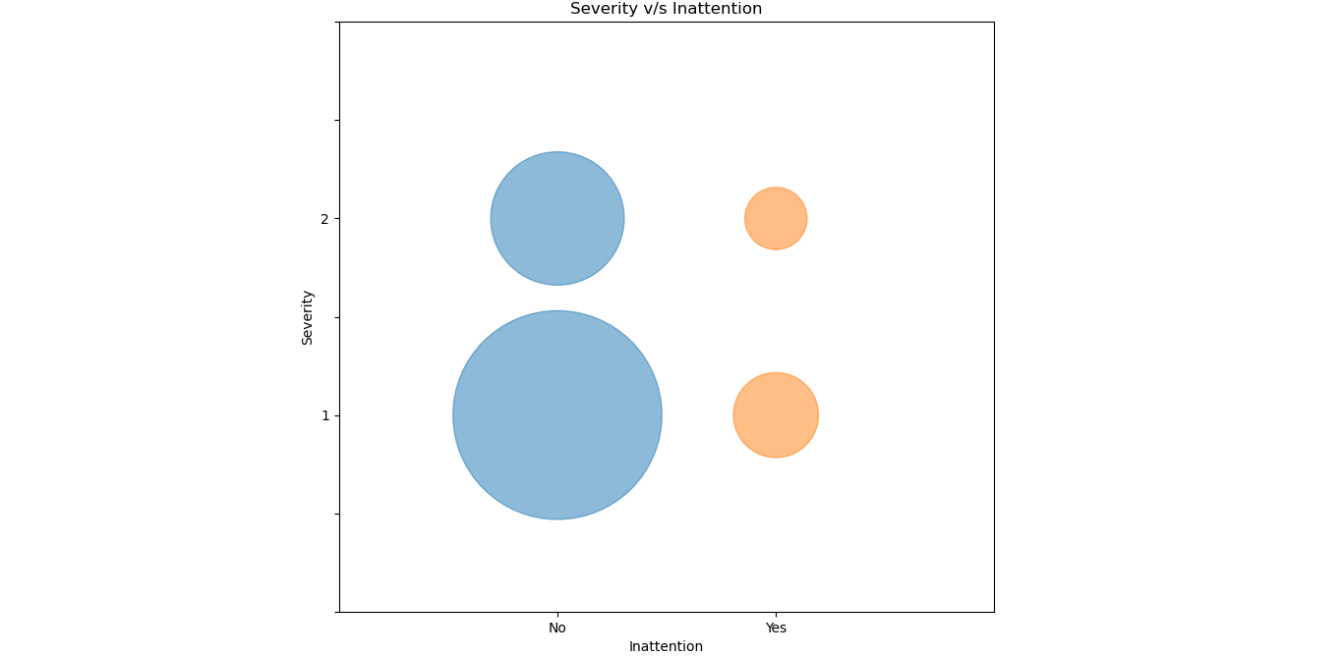
Severity vs Inattention –
Inattention | Severity = 1 | Severity = 2 | severity = 2 cases %age of total cases
Yes | 19408 | 10397 | 34.88%
no | 117077 | 47791 | 28.99%
Yes cases %age | 14.22% | 17.87%

Slide 12

Severity vs Influence –
Influence | Severity = 1 | Severity = 2 | severity = 2 cases %age of total cases
Yes | 5559 | 3562 | 39.05%
no | 130926 | 54626 | 29.44%
Yes cases %age | 4.07% | 6.12%

Slide 13
Predictive modelling – Since we need to predict the class of severity, classification models were used.
Four classification models were used –
K-Nearest Neighbor Model
Decision Tree Model
Logistic Regression Model
Support Vector Machine Model (Only accuracy was calculated and then this model was dropped because of its higher CPU configuration demand.)
The size of test data was 20% of the total data provided.

Slide 14
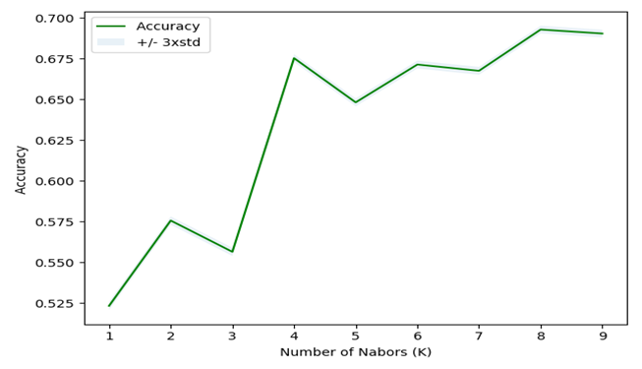
K-Nearest neighbors model – Test data size = 20% initial k value = 4
From the above output graph it can be seen that at k = 8, the model has maximum value of 0.693.
F1 value at k = 8 is 0.598.
Log Loss at k = 8 is 1.40.

Slide 15
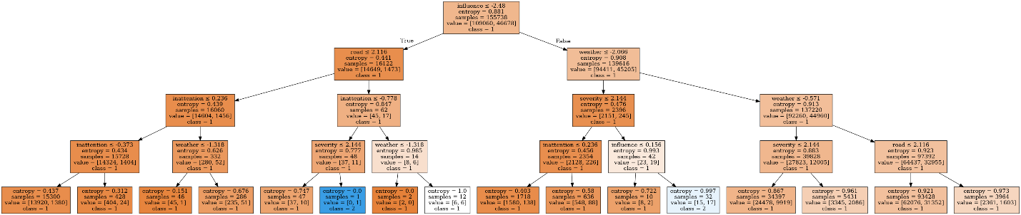
Decision tree model – Test data size = 20% Max depth = 4
Accuracy = 0.704.
F1 value = 0.582.
Log Loss = 0.588.

Slide 16
Logistic regression model – Test data size = 20%
Accuracy = 0.704.
F1 value = 0.583.
Log Loss = 0.589.
Support Vector machine model – Test data size = 20%
Accuracy = 0.704.

Slide 17
Results and conclusion –
Serial number | Model | Accuracy | F1 Score | logloss
1. | K – Nearest Neighbors | 0.693 | 0.598 | 1.40
2. | Decision Tree | 0.704 | 0.582 | 0.588
3. | Logistic Regression | 0.704 | 0.583 | 0.589
4. | Support Vector Machine | 0.704 | - | -
From the above data, Decision Tree model has the best accuracy and lowest Log Loss value which makes it the best model to predict the severity.

